Slide 1
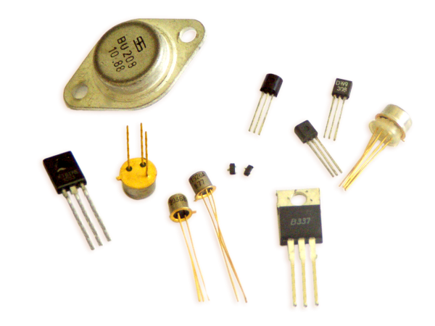
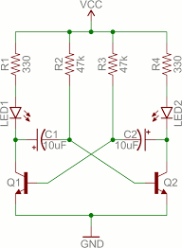
Using, Choosing and Abusing Transistors
Ray Crampton, Feb 2019

Slide 2


Rules of thumb, assumptions and mixed-quality analogies to come!

Slide 3
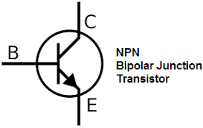
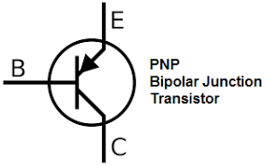
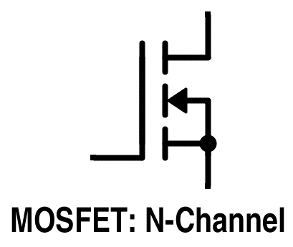
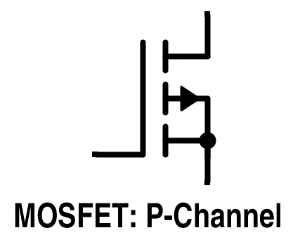
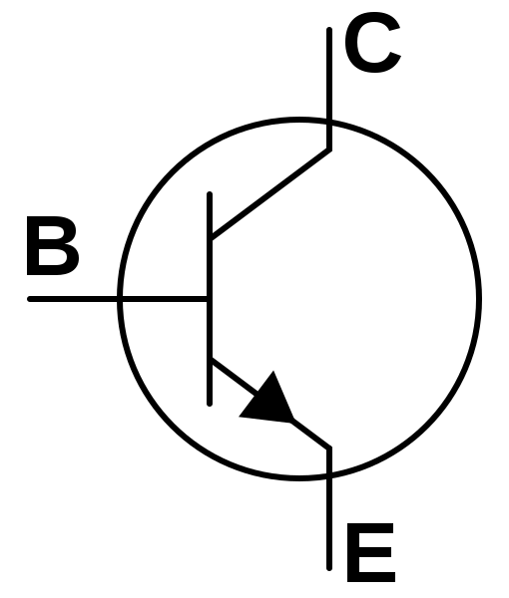
Common Types of Transistors
drain
drain
gate
gate
source
source
BJT – Base/Emitter/Collector
FETs – Gate/Drain/Source
“IN”
Control
Terminal
“OUT”

Slide 4


Transistor as a Switch Plumbing Analogy
Collector
Emitter
“IN”
“OUT”
Base
“Control”

Slide 5
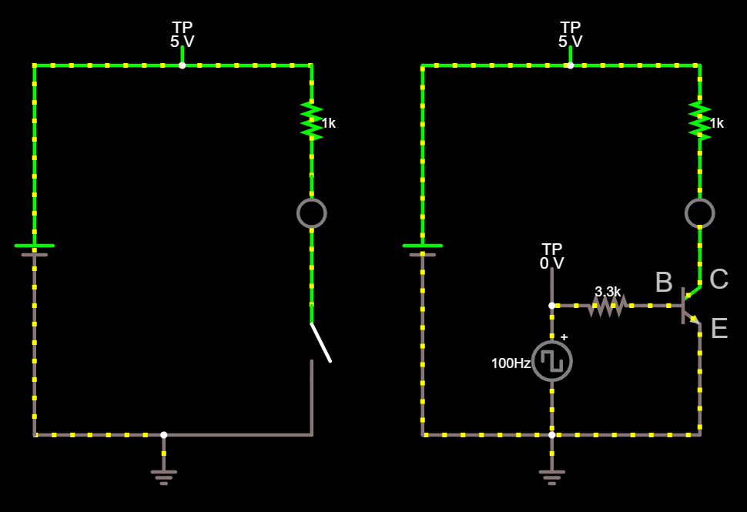
Falstad.com simulation of NPN Switch
http://falstad.com/circuit/circuitjs.html?cct=$+1+0.000005+3.9121283998153213+59+5+43%0Aw+80+80+192+80+0%0Aw+64+416+64+400+0%0Ag+64+416+64+432+0%0A368+80+80+80+48+0+0%0Aw+-48+400+64+400+0%0Aw+-48+80+80+80+0%0Av+-48+400+-48+80+0+0+40+5+0+0+0.5%0Aw+192+240+192+288+0%0Aw+192+160+192+176+0%0Ar+192+96+192+160+0+1000%0A162+192+176+192+240+2+default-led+1+0+0+0.01%0Aw+192+352+192+400+0%0Aw+192+400+64+400+0%0As+192+288+192+352+0+1+true%0Aw+192+80+192+96+0%0Aw+528+96+528+80+0%0Aw+416+80+528+80+0%0Aw+400+384+400+400+0%0Aw+400+272+400+288+0%0A368+400+272+400+240+0+0%0Aw+400+416+400+400+0%0Ag+400+416+400+432+0%0A368+416+80+416+48+0+0%0Aw+288+400+400+400+0%0Aw+288+80+416+80+0%0Av+288+400+288+80+0+0+40+5+0+0+0.5%0Aw+528+240+528+272+0%0Aw+528+160+528+176+0%0Ar+528+96+528+160+0+1000%0A162+528+176+528+240+2+default-led+1+0+0+0.01%0Aw+528+304+528+400+0%0Aw+528+400+400+400+0%0Av+400+384+400+288+0+2+100+2.5+2.5+0+0.5%0At+496+288+528+288+0+1+-4.9998025122489524+3.4649934824506973e-10+100%0Ar+416+288+480+288+0+3300%0Aw+480+288+496+288+0%0Aw+416+288+400+288+0%0Ax+489+276+505+279+4+24+B%0Ax+536+273+553+276+4+24+C%0Ax+537+316+553+319+4+24+E%0A

Slide 6
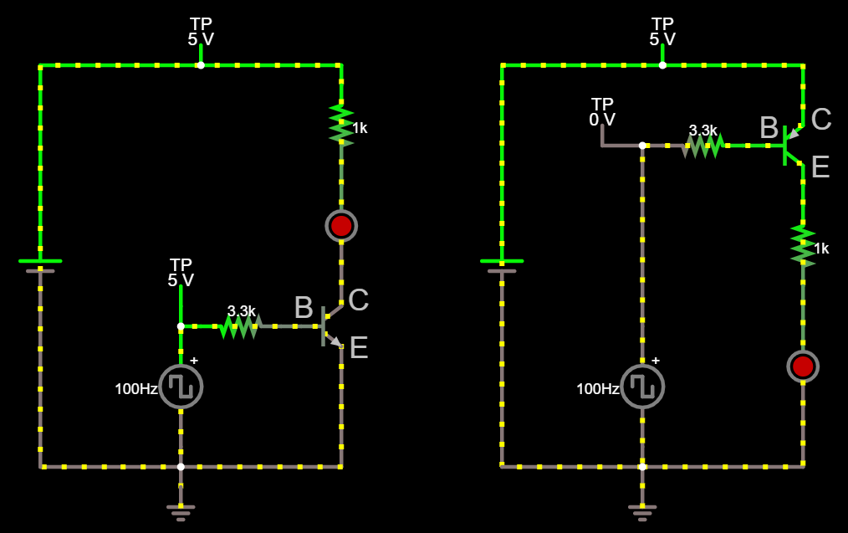
BJT: PNP vs NPN “High Side” vs “Low Side”
http://falstad.com/circuit/circuitjs.html?cct=$+1+0.000005+3.9121283998153213+59+5+43%0Aw+176+128+176+112+0%0Aw+64+112+176+112+0%0Aw+48+416+48+432+0%0Aw+48+304+48+320+0%0A368+48+304+48+272+0+0%0Aw+48+448+48+432+0%0Ag+48+448+48+464+0%0A368+64+112+64+80+0+0%0Aw+-64+432+48+432+0%0Aw+-64+112+64+112+0%0Av+-64+432+-64+112+0+0+40+5+0+0+0.5%0Aw+176+272+176+304+0%0Aw+176+192+176+208+0%0Ar+176+128+176+192+0+1000%0A162+176+208+176+272+2+default-led+1+0+0+0.01%0Aw+176+336+176+432+0%0Aw+176+432+48+432+0%0Av+48+416+48+320+0+2+100+2.5+2.5+0+0.5%0At+144+320+176+320+0+1+-4.999811893634119+3.464993792036408e-10+100%0Ar+64+320+128+320+0+3300%0Aw+128+320+144+320+0%0Aw+64+320+48+320+0%0Aw+496+176+512+176+0%0Ar+432+176+496+176+0+3300%0Av+416+416+416+320+0+2+100+2.5+2.5+3.141592653589793+0.5%0Aw+544+432+416+432+0%0Aw+544+384+544+432+0%0A162+544+320+544+384+2+default-led+1+0+0+0.01%0Ar+544+224+544+288+0+1000%0Aw+544+192+544+208+0%0Av+304+432+304+112+0+0+40+5+0+0+0.5%0Aw+304+112+432+112+0%0Aw+304+432+416+432+0%0A368+432+112+432+80+0+0%0Ag+416+448+416+464+0%0Aw+416+448+416+432+0%0A368+384+176+384+144+0+0%0Aw+416+176+416+320+0%0Aw+416+416+416+432+0%0Aw+432+112+544+112+0%0Aw+544+128+544+112+0%0At+512+176+544+176+0+-1+4.999788025922517+-3.4649882962867196e-10+10000%0Aw+544+160+544+128+0%0Aw+544+208+544+224+0%0Aw+544+288+544+320+0%0Aw+416+176+432+176+0%0Aw+416+176+384+176+0%0A

Slide 7
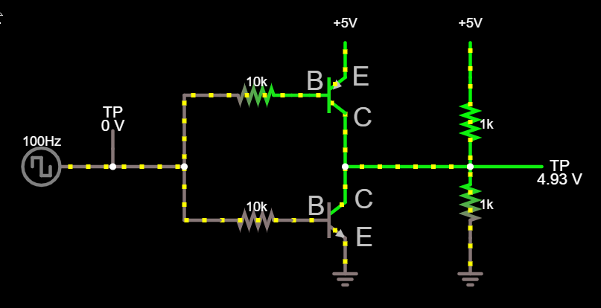
Complementary Bipolar
http://falstad.com/circuit/circuitjs.html?cct=$+1+0.000005+3.9121283998153213+59+5+43%0At+224+320+272+320+0+1+0.5705218733467872+0.6402159636357576+100%0Ar+160+320+224+320+0+10000%0Aw+224+208+240+208+0%0Ar+160+208+224+208+0+10000%0Ar+384+272+384+336+0+1000%0Aw+272+224+272+240+0%0A368+64+256+64+224+0+0%0At+240+208+272+208+0+-1+4.930305908661726+-1.0493037549963447e-9+10000%0Aw+272+240+272+272+0%0AR+272+192+272+144+0+0+40+5+0+0+0.5%0Aw+272+272+272+304+0%0Aw+272+272+384+272+0%0Ar+384+192+384+272+0+1000%0AR+384+192+384+144+0+0+40+5+0+0+0.5%0Ag+384+336+384+368+0%0Aw+160+208+128+208+0%0Aw+128+208+128+272+0%0Aw+128+272+128+320+0%0Aw+160+320+128+320+0%0AR+64+272+0+272+0+2+100+2.5+2.5+0+0.5%0Aw+64+272+128+272+0%0Aw+64+256+64+272+0%0Ag+272+336+272+368+0%0A368+384+272+464+272+0+0%0Ax+279+236+296+239+4+24+C%0Ax+237+203+253+206+4+24+B%0Ax+280+309+297+312+4+24+C%0Ax+238+315+254+318+4+24+B%0Ax+281+343+297+346+4+24+E%0Ax+278+199+294+202+4+24+E%0A

Slide 8
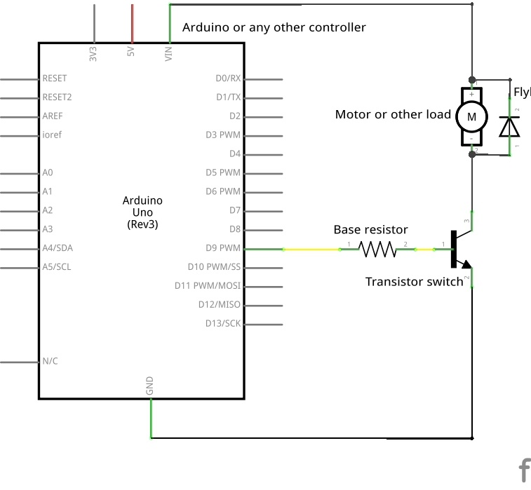
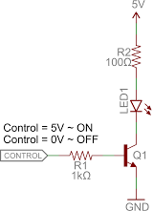
BJT Motor or LED Driver Example

Slide 9
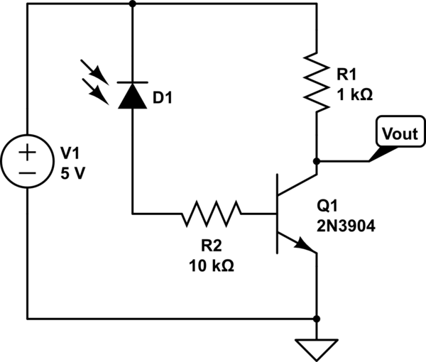
BJT Photodiode Example

Slide 10
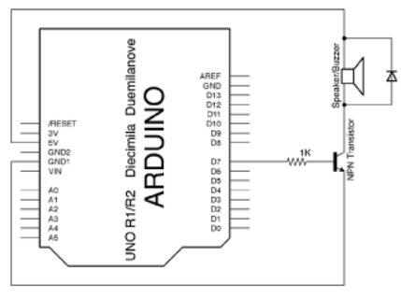
BJT Speaker Driver Example

Slide 11
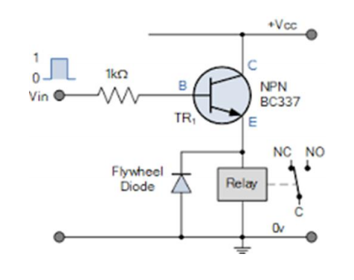
BJT Relay Example

Slide 12
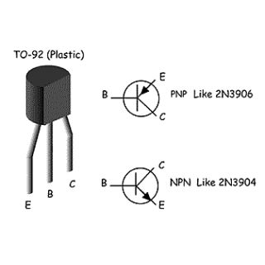
Common Bipolar Pinouts

Slide 13
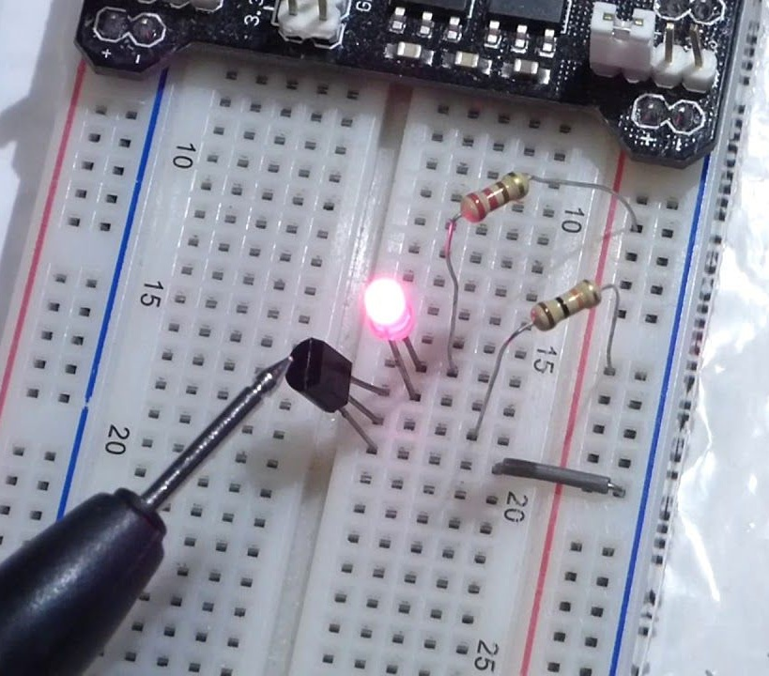
Typical Breadboard Application

Slide 14
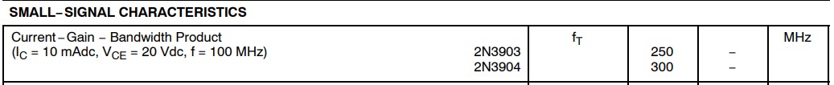
Key Bipolar Transistor Specs
Collector-emitter Breakdown Voltage
Maximum operating C-E should be 20-50% lower
Maximum continuous collector current
You should be below this with some margin ~20%
f_{T} – frequency at which gain falls to 1
Should be > 100x your operating frequency
Avoid super high frequency transistors (1GHz!)

Slide 15
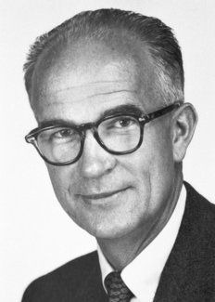
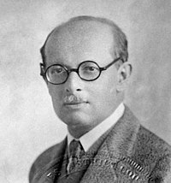
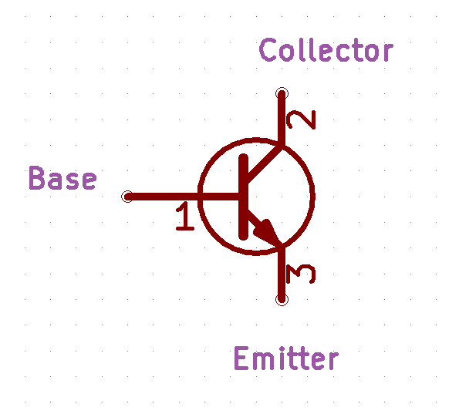

BJT vs FET as a Switch
W. Shockley
1947
Nobel Prize 1956
J. E. Lilienfeld
1925
Collector
Drain
Base
Gate
Emitter
Source
Current Controlled
Voltage Controlled

Slide 16
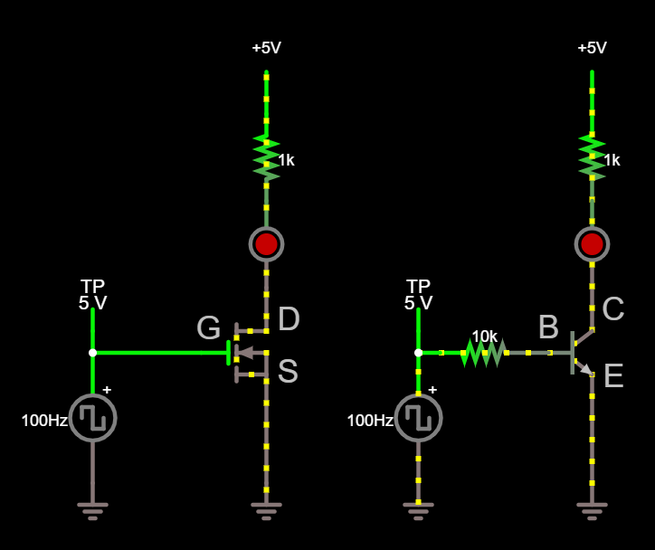
FET vs BJT in Operation
http://falstad.com/circuit/circuitjs.html?cct=$+1+0.000005+3.9121283998153213+59+5+43%0Av+80+384+80+288+0+2+100+2.5+2.5+0+0.5%0Aw+80+288+160+288+0%0A162+208+176+208+240+2+default-led+1+0+0+0.01%0Ar+208+112+208+176+0+1000%0Aw+208+240+208+272+0%0Ag+80+384+80+400+0%0A368+80+272+80+240+0+0%0Aw+80+272+80+288+0%0Aw+320+272+320+288+0%0A368+320+272+320+240+0+0%0Ag+320+384+320+400+0%0Aw+448+240+448+272+0%0Ar+448+112+448+176+0+1000%0A162+448+176+448+240+2+default-led+1+0+0+0.01%0Aw+448+304+448+384+0%0Av+320+384+320+288+0+2+100+2.5+2.5+0+0.5%0At+416+288+448+288+0+1+-4.999808758737633+1.049998087170923e-9+100%0Ar+336+288+400+288+0+10000%0Aw+400+288+416+288+0%0Aw+336+288+320+288+0%0AR+448+112+448+64+0+0+40+5+0+0+0.5%0Ag+448+384+448+400+0%0Aw+208+304+208+384+0%0Ag+208+384+208+400+0%0AR+208+112+208+64+0+0+40+5+0+0+0.5%0Af+160+288+208+288+32+1.5+1%0A

Slide 17
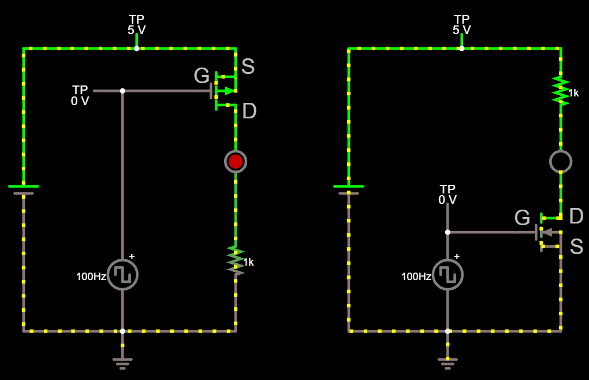
MOSFETs: NMOS vs PMOS
http://falstad.com/circuit/circuitjs.html?cct=$+1+0.000005+3.9121283998153213+59+5+43%0Av+432+416+432+320+0+2+100+2.5+2.5+3.141592653589793+0.5%0Aw+560+432+432+432+0%0Aw+560+336+560+432+0%0Aw+432+320+512+320+0%0A162+560+208+560+272+2+default-led+1+0+0+0.01%0Ar+560+128+560+192+0+1000%0Aw+560+192+560+208+0%0Aw+560+272+560+304+0%0Av+320+432+320+112+0+0+40+5+0+0+0.5%0Aw+320+112+448+112+0%0Aw+320+432+432+432+0%0A368+448+112+448+80+0+0%0Ag+432+448+432+464+0%0Aw+432+448+432+432+0%0A368+432+304+432+272+0+0%0Aw+432+304+432+320+0%0Aw+432+416+432+432+0%0Aw+448+112+560+112+0%0Aw+80+112+192+112+0%0Aw+64+448+64+432+0%0Ag+64+448+64+464+0%0A368+80+112+80+80+0+0%0Aw+-48+432+64+432+0%0Aw+-48+112+80+112+0%0Av+-48+432+-48+112+0+0+40+5+0+0+0.5%0Aw+192+272+192+320+0%0Aw+192+192+192+208+0%0Ar+192+320+192+384+0+1000%0A162+192+208+192+272+2+default-led+1+0+0+0.01%0Aw+192+384+192+432+0%0Aw+192+432+64+432+0%0Aw+192+112+192+128+0%0Aw+560+128+560+112+0%0Af+512+320+560+320+32+1.5+0.02%0Av+64+416+64+320+0+2+100+2.5+2.5+3.141592653589793+0.5%0Aw+64+416+64+432+0%0Af+144+160+192+160+33+1.5+0.02%0Aw+192+128+192+144+0%0Aw+192+176+192+192+0%0Aw+144+160+64+160+0%0Aw+64+320+64+160+0%0A368+48+160+16+160+0+0%0Aw+48+160+64+160+0%0Ax+144+151+162+154+4+24+G%0Ax+198+141+214+144+4+24+S%0Ax+199+191+216+194+4+24+D%0Ax+569+310+586+313+4+24+D%0Ax+570+345+586+348+4+24+S%0Ax+507+312+525+315+4+24+G%0A

Slide 18
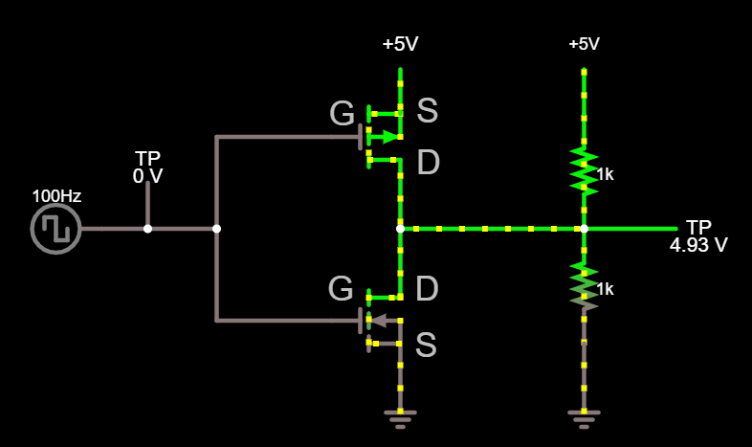
CMOS Output
http://falstad.com/circuit/circuitjs.html?cct=$+1+0.000005+3.9121283998153213+59+5+43%0Ar+432+272+432+352+0+1000%0Ag+304+352+304+400+0%0A368+432+272+512+272+0+0%0Aw+304+272+304+320+0%0Af+256+336+304+336+32+1.5+0.02%0Af+256+208+304+208+33+1.5+0.02%0A368+128+272+128+224+0+0%0Ax+244+189+262+192+4+24+G%0Ax+319+195+335+198+4+24+S%0Ax+321+237+338+240+4+24+D%0AR+304+192+304+144+0+0+40+5+0+0+0.5%0Aw+304+224+304+272+0%0Aw+304+272+368+272+0%0Aw+256+208+176+208+0%0Aw+176+336+256+336+0%0Aw+176+272+128+272+0%0Aw+128+272+96+272+0%0AR+96+272+64+272+0+2+100+2.5+2.5+0+0.5%0Ar+432+192+432+272+0+1000%0Ag+432+352+432+400+0%0AR+432+192+432+144+0+0+40+5+0+0+0.5%0Aw+368+272+432+272+0%0Aw+176+208+176+272+0%0Aw+176+272+176+336+0%0A

Slide 19
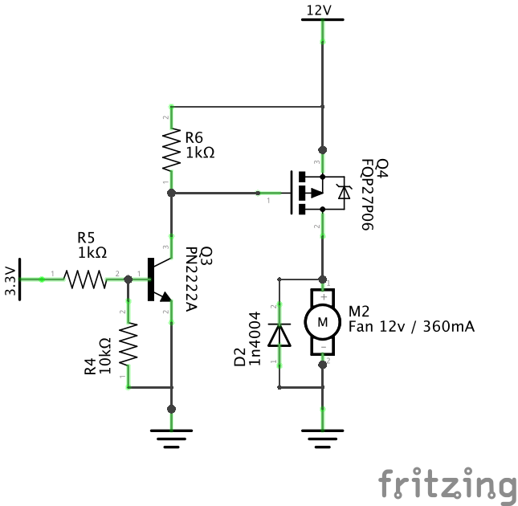
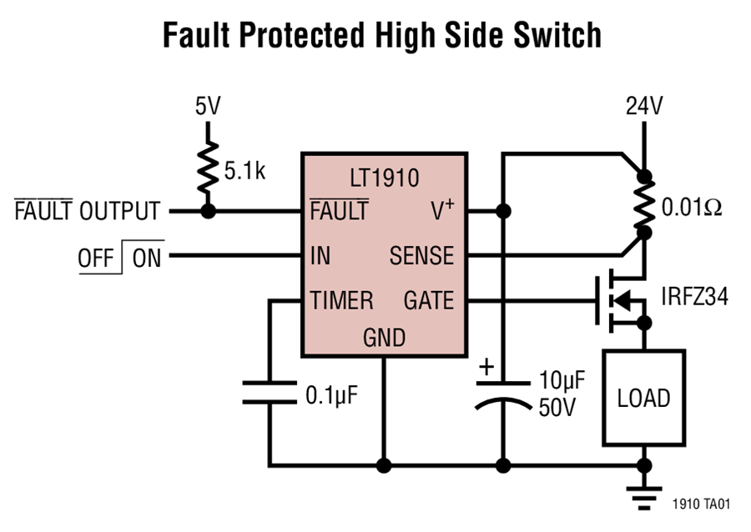
MOSFET Examples
Note the “body diode” which is intrinsic to all MOSFETs

Slide 20
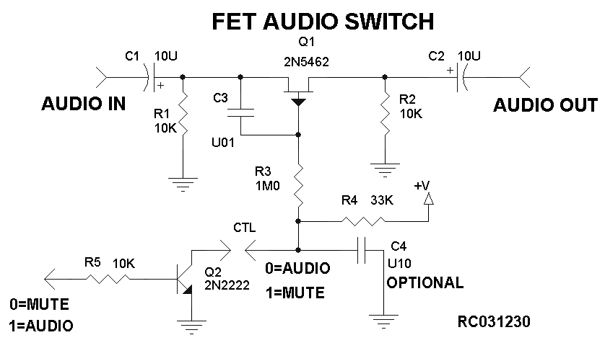
FET Example

Slide 21
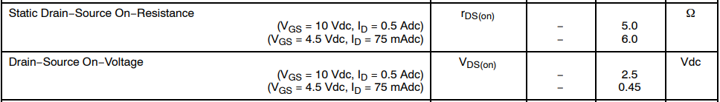
Key MOSFET Specs
Drain-Source Breakdown Voltage
Maximum operating D-S should be 20-50% lower
Gate threshold voltage
You should be well above/below this
On-Voltage
Should be low enough

Slide 22
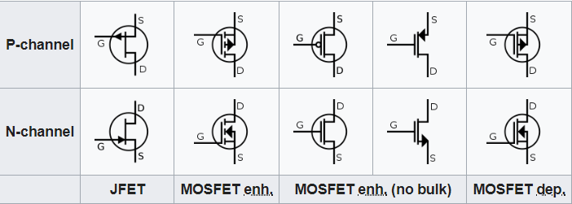
MOSFET Schematic Symbols
There are many, many variations on these
FETs of the same type (P vs N) behave similar to each other
Be aware but don’t fret over it too much

Slide 23
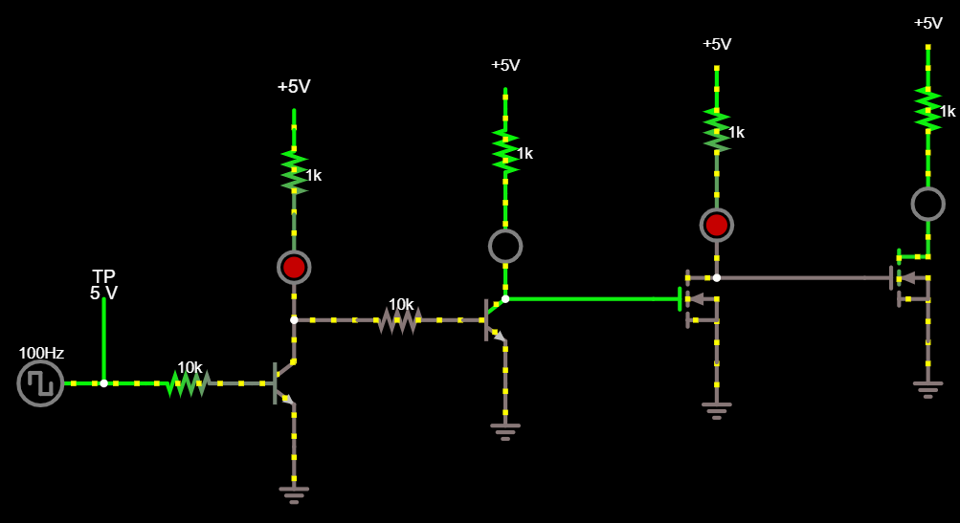
“Common Emitter/Source” Inverts
http://falstad.com/circuit/circuitjs.html?cct=$+1+0.000005+3.9121283998153213+59+5+43%0Ar+464+240+464+304+0+1000%0Ag+272+336+272+368+0%0Aw+272+240+272+272+0%0At+240+288+272+288+0+1+0.5705218733467888+0.640215963635758+100%0Ar+160+288+224+288+0+10000%0Aw+224+288+240+288+0%0A368+96+240+96+160+0+0%0At+240+192+272+192+0+-1+4.930305908661727+-1.0493037549963447e-9+10000%0Aw+272+208+272+240+0%0AR+272+144+272+112+0+0+40+5+0+0+0.5%0Aw+272+144+272+176+0%0Aw+272+304+272+336+0%0Ar+160+192+224+192+0+10000%0Aw+160+288+128+288+0%0Aw+160+192+128+192+0%0Aw+128+192+128+240+0%0Aw+128+240+128+288+0%0Aw+128+240+96+240+0%0AR+96+240+48+240+0+2+100+2.5+2.5+0+0.5%0Ar+464+176+464+240+0+1000%0Ag+464+304+464+336+0%0AR+464+176+464+144+0+0+40+5+0+0+0.5%0A368+400+240+400+160+0+0%0Aw+464+240+400+240+0%0Aw+400+240+272+240+0%0Ax+308+201+357+204+4+24+PNP%0Ax+305+300+355+303+4+24+NPN%0Ax+235+181+251+184+4+24+B%0Ax+236+278+252+281+4+24+B%0Aw+240+192+224+192+0%0Ax+280+274+297+277+4+24+C%0Ax+280+220+297+223+4+24+C%0Ax+281+320+297+323+4+24+E%0Ax+280+177+296+180+4+24+E%0A

Slide 24
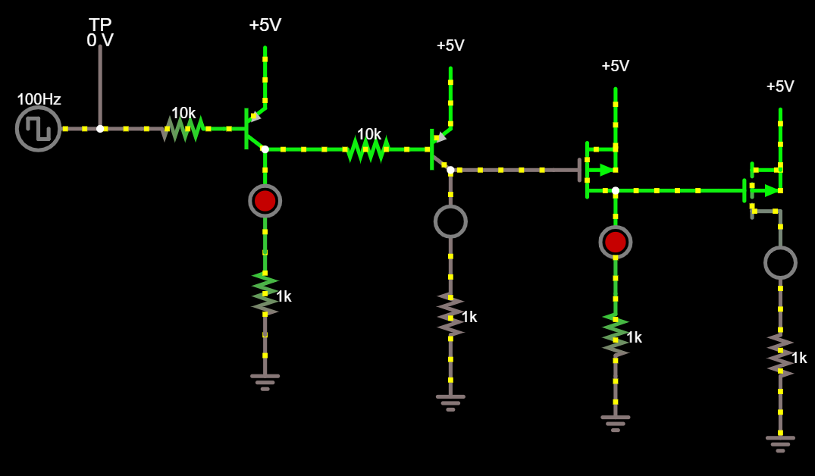
Same on the High Side
http://falstad.com/circuit/circuitjs.html?cct=$+1+0.000005+3.9121283998153213+59+5+43%0Ar+0+320+64+320+0+10000%0Aw+64+320+80+320+0%0A368+-32+320+-32+240+0+0%0AR+112+304+112+224+0+0+40+5+0+0+0.5%0Aw+0+320+-32+320+0%0AR+-32+320+-80+320+0+2+100+2.5+2.5+0+0.5%0Aw+160+336+112+336+0%0A162+272+352+272+432+2+default-led+1+0+0+0.01%0Ar+272+432+272+496+0+1000%0AR+272+320+272+224+0+0+40+5+0+0+0.5%0Aw+224+336+240+336+0%0Ar+160+336+224+336+0+10000%0Ag+272+496+272+528+0%0Aw+384+352+272+352+0%0At+80+320+112+320+0+-1+-0.5716207307972958+-0.6317815784740484+100%0At+240+336+272+336+0+-1+4.9386779068845374+-0.06016084863317328+100%0Ag+112+480+112+512+0%0Ar+112+416+112+480+0+1000%0A162+112+336+112+416+2+default-led+1+0+0+0.01%0Af+384+352+432+352+33+1.5+0.02%0Ag+432+512+432+544+0%0Ar+432+448+432+512+0+1000%0A162+432+368+432+448+2+default-led+1+0+0+0.01%0AR+432+336+432+240+0+0+40+5+0+0+0.5%0AR+592+352+592+256+0+0+40+5+0+0+0.5%0A162+592+384+592+464+2+default-led+1+0+0+0.01%0Ar+592+464+592+528+0+1000%0Ag+592+528+592+560+0%0Af+544+368+592+368+33+1.5+0.02%0Aw+544+368+432+368+0%0A

Slide 25

Transistors as Amplifiers

Slide 26
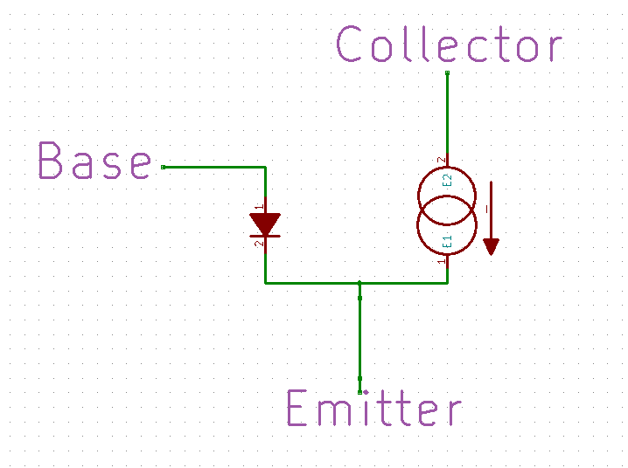
A More Accurate NPN Model
I_{B}
I_{C} = β x I_{B}
β (aka h_{fe}) is the “current gain” of the device

Slide 27
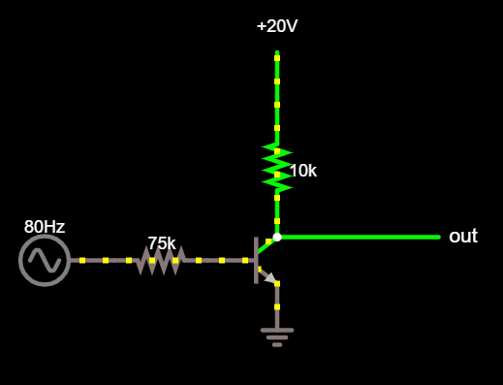
A Bad Common Emitter Amplifier
http://falstad.com/circuit/circuitjs.html?cct=$+1+0.000005+16.13108636308289+60+15+53%0Ar+208+272+272+272+0+75000%0At+272+272+320+272+0+1+-18.713788175122275+0.528820044743417+100%0Ag+320+288+320+320+0%0AR+320+160+320+112+0+0+40+20+0+0+0.5%0Ar+320+160+320+256+0+10000%0AR+208+272+160+272+0+1+80+1+1+0+0.5%0AO+320+256+448+256+0%0Ao+5+32+0+4614+3.9999999999999996+0.0001+0+2+5+3%0Ao+6+32+0+4614+19.999999997799996+0.0001+0+1%0A

Slide 28
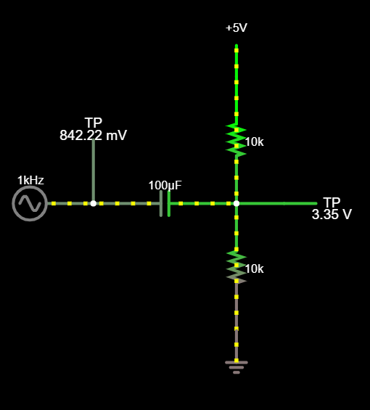
A Bias Tee
http://falstad.com/circuit/circuitjs.html?cct=$+1+0.000015625+1.1208435524800693+59+5+43%0Ar+272+112+272+240+0+10000%0AR+128+240+64+240+0+1+1000+1+0+0+0.5%0Ar+272+240+272+368+0+10000%0Ac+128+240+272+240+0+0.00009999999999999999+-2.507888356202867%0AR+272+112+272+64+0+0+40+5+0+0+0.5%0Ag+272+368+272+400+0%0Aw+320+240+272+240+0%0A368+320+240+368+240+0+0%0A368+128+240+128+160+0+0%0Ao+8+2+0+4098+5+0.1+0+2+7+0%0A

Slide 29
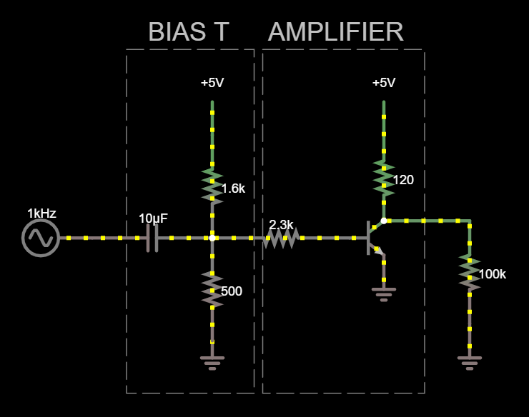
A Mediocre CE Amplifier
http://falstad.com/circuit/circuitjs.html?cct=$+1+0.000005+1.5642631884188172+60+15+53%0Ag+176+320+176+336+0%0AR+176+128+176+80+0+0+40+5+0+0+0.5%0Ar+176+128+176+224+0+1600%0AR+64+224+16+224+0+1+1000+0.5+0.5+0+0.5%0Ar+176+224+176+320+0+500%0Ac+64+224+176+224+0+0.00001+-0.6202998006592448%0At+304+224+336+224+0+1+0.4226432803100168+0.6906075355751219+100%0Ar+176+224+304+224+0+2300%0Ag+336+240+336+272+0%0Ar+336+128+336+208+0+120%0AR+336+128+336+80+0+0+40+5+0+0+0.5%0Ax+116+40+192+43+4+24+BIAS%5CsT%0Ab+96+48+215+369+0%0Ab+223+48+374+369+0%0Ax+228+40+354+43+4+24+AMPLIFIER%0Aw+336+208+416+208+0%0Ar+416+208+416+304+0+100000%0Ag+416+304+416+336+0%0Ao+3+2+0+20998+1.9999999999999998+0.0001+0+2+3+3%0Ao+15+2+0+20738+5+0.1+1+2+15+3%0A

Slide 30
Problems with this amplifier
Problems
Gain will vary too much with β (h_{fe}) variation
Linearity isn’t very good
Input dynamic range is poor
Circuit needs fine-tuning per transistor used

Slide 31
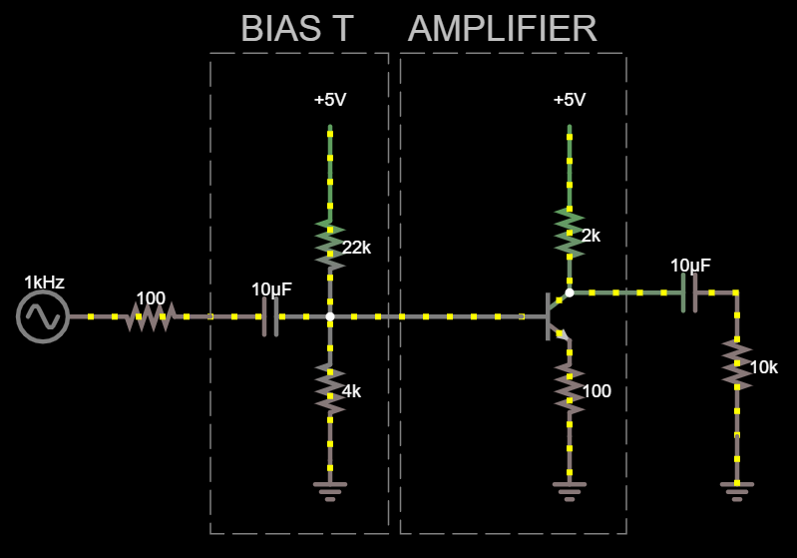
Emitter Resistor
Gain ~= -Rc/Re
Improved distortion
Improved dynamic range
Less sensitive to individual transistor characteristics

Slide 32
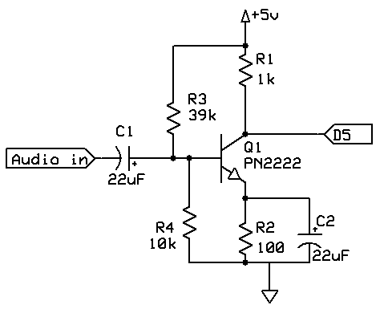
Example circuits

Slide 33
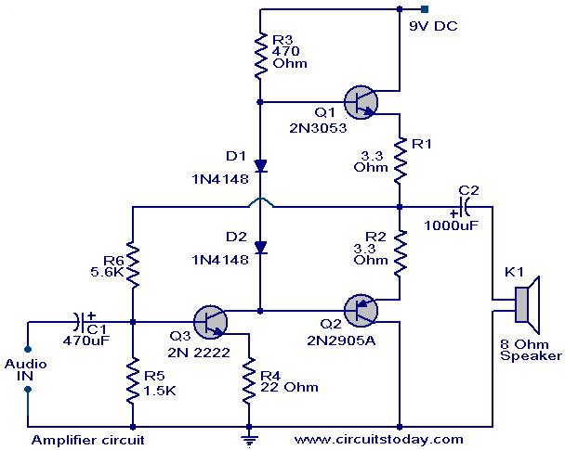
Example circuits

Slide 34
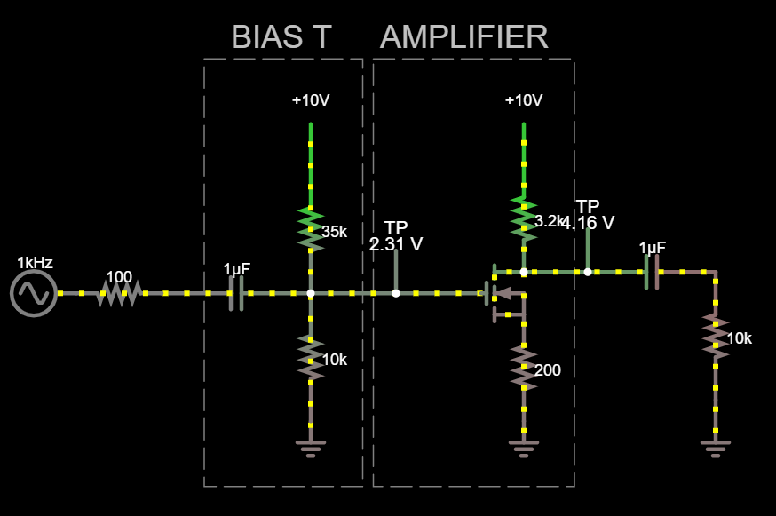
A more accurate FET model
Drain
Gate
I = g_{m}*V_{gs}
+
V_{gs}
₋
Source

Slide 35

FETs vs BJTs – Which is best?
Questionable generalizations! | Bipolar (BJT) | FET (MOSFET)
Speed
Gate/base current
On-state voltage drop
Low voltage circuits, esp when controlling high current
Ease of selection/application | (?) | (?)
Practical guidance/tendencies:
Low power, low voltage -> bipolar
High current -> FET
High efficiency switching supplies -> FET

Slide 36

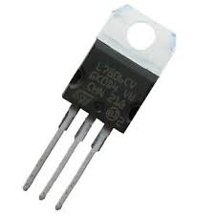
Go-to Transistors
Bipolar – the workhorse for enthusiasts
2N3904 – NPN, 40V, 200mA, 300MHz f_{T}
2N3906 – PNP, -40V. 200mA, 250MHz f_{T}
TIP120 – NPN, 60V, 5A
MOSFETs
Probably don’t want to stock FETs
Wanna play? 2N7000, 2N7002 - NMOS

